Slide 1
Boolean Algebra

Slide 2
Boolean algebra was used to design the switching circuit of the computer.
By using boolean algebra,the computer can do logical thinking very fast and inexpensively.
Boolean algebra was developed by George Bool.

Slide 3
Boolean algebra may operate on practically any kind of set and when a boolean equation is solved,the result is only one out of two terms TRUE or NOT TRUE.
The algebra which deals with only two quantities that are either true or false is called Boolean Algebra.

Slide 4
The truth value TRUE of boolean algebra is denoted by 1 and the truth value FALSE is denoted by 0.

Slide 5
Truth Table
Truth table is the tabular representation of all the possible values of logical variables/statements with all the possible results for the given combination of values.

Slide 6
The truth table consists of two parts.They are rows and columns.
The horizontal lines of truth table are called rows.
The number of rows depends on the number of input variables Eg. Two inputs then there will be 2²=4
The number of vertical lines are called columns

Slide 7
LOGICAL OPERATORS
1)NOT
2)AND
3)OR

Slide 8
NOT operator
The operator is a unary operator because it operates on a single variable.This operator is called complement and the symbol for this is –
(bar) or ‘ .
Eg X or X
The variable used can have two possible values 0 or 1 where 0 denotes false and 1 denotes true.

Slide 9
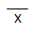
Truth table of Not
X
0 | 1
1 | 0

Slide 10
AND Operator
The AND operator operates on two or more operators.
AND operator is used to perform logical multiplication and the symbol is dot (.)

Slide 11
Truth Table for AND operator
X | Y | X.Y
0 | 0 | 0
0 | 1 | 0
1 | 0 | 0
1 | 1 | 1
Note That only when both X and Y are 1,then X.Y has the result 1.

Slide 12
OR operator
The OR operator is used to perform logical addition and the symbol for OR operator is (+) plus.

Slide 13
Truth table for OR operator
X | Y | X+Y
0 | 0 | 0
0 | 1 | 1
1 | 0 | 1
1 | 1 | 1

Slide 14
Evaluation of boolean expression using truth table
Logical variables are combined by means of logical operators(AND,OR,NOT) to form a boolean expression.

Slide 15
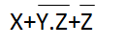
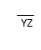
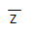
For Example
X | Y | Z | YZ
0 | 0 | 0 | 0 | 1 | 1 | 1
0 | 0 | 1 | 0 | 1 | 0 | 1
0 | 1 | 0 | 0 | 1 | 1 | 1
0 | 1 | 1 | 1 | 0 | 0 | 0
1 | 0 | 0 | 0 | 1 | 1 | 1
1 | 0 | 1 | 0 | 1 | 0 | 1
1 | 1 | 0 | 0 | 1 | 1 | 1
1 | 1 | 1 | 1 | 0 | 0 | 1

Slide 16
Basic Logic gates
A gate is simply an electronic circuit which operates on one or more signal to produce an output signal.
Fundamental Gates
Derived Gates

Slide 17
Fundamental Gates
These are the basic gates which are not constructed from other gates these are
1)AND gate
2)OR gate
3)NOT gate

Slide 18
AND GATE
This gate has two or more input signals but only one output signal.This gate producesoutput 1 when all inputs are 1

Slide 19
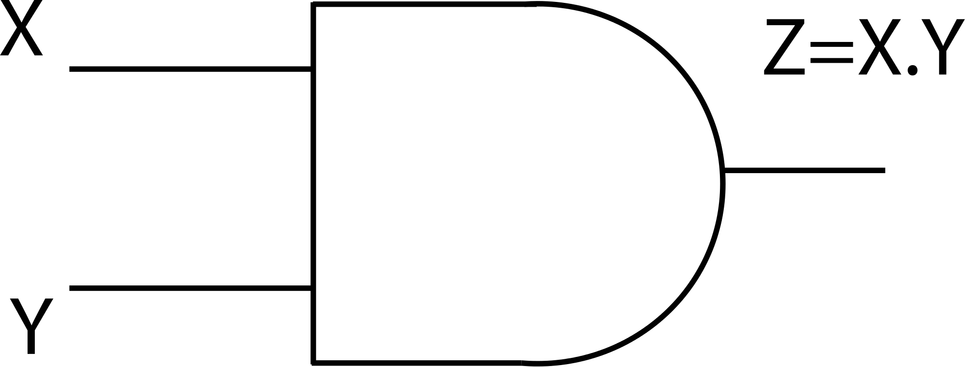
X | Y | Z(X.Y)
0 | 0 | 0
0 | 1 | 0
1 | 0 | 1
1 | 1 | 1

Slide 20
OR gate
This gate has 2 or more input signals but only one output signals.This gate produces output 1 when any of the inputs are 1.

Slide 21
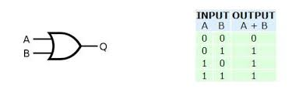

Slide 22
NOT gate
The NOT gate has only one input and one output signal.The output state is always the opposite of the input state.
This gate is also called the complement gate because it complements the input value.

Slide 23
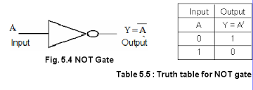

Slide 24
DERIVED GATES
These gates are derived from the fundamental gates.These are
1)NOR gate
2)NAND gate
3)XOR gate
4)XNOR gate

Slide 25
NOR gate
This gate is the combination of the NOT and the OR gate.The NOR gate has two or more inputs but only one output.
It produces output 1 when all inputs are 0.

Slide 26
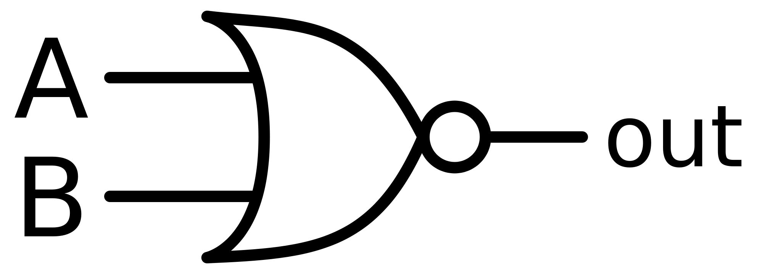
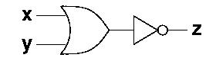

Slide 27
TRUTH Table NOR gate
X | Y | X+Y’
0 | 0 | 1
0 | 1 | 0
1 | 0 | 0
1 | 1 | 0

Slide 28
NAND Gate
This gate is the combination of the NOT and the AND gate.
The NAND gate has two or more input signals but only one output signal.
If all inputs are 1 then output produced is 0.

Slide 29
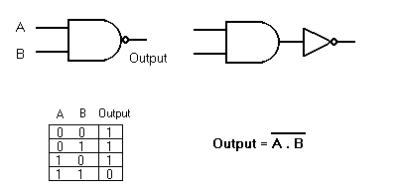

Slide 30
XOR gate(Exclusive OR)
The exclusive OR gate can have two or more inputs but produces one output signal.
Exclusive OR is different from OR gate.
OR gate produces output signal 1 for any input combinations having 1 or more 1’s,but exclusive OR gate produces output 1 for only those input combinations that have odd number of 1’s.

Slide 31
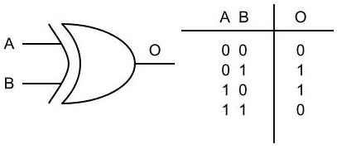
In Boolean algebra XOR gate is Represented by

Slide 32
XNOR gate(Exclusive NOR)
The exclusive NOR gate is the complement of XOR gate(exclusive OR gate)
It recognizes the pair that has even number of 1’s.
Logically Exclusive NOR gate (XNOR)is equivalent to an inverted XOR gate.

Slide 33
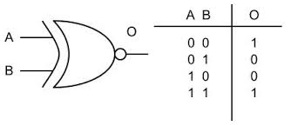
A XNOR B=A
B

Slide 34
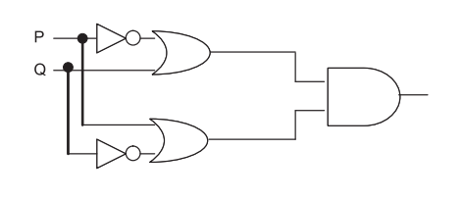
Write the equivalent Boolean Expression for the following Logic Circuit
F(P,Q)=(P'+Q).(P+Q')

Slide 35
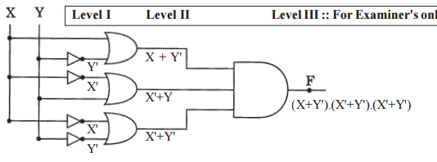
Draw the circuit for the following equation (X+Y').(X'+Y').(X'+Y')

Slide 36
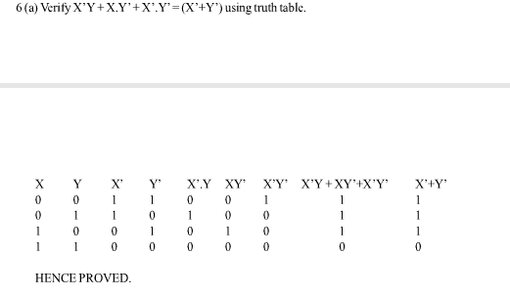

Slide 37
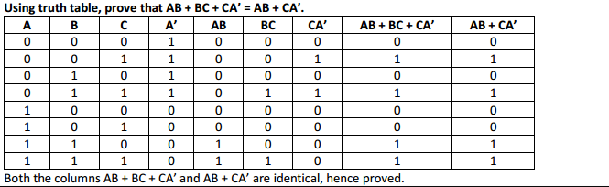

Slide 38
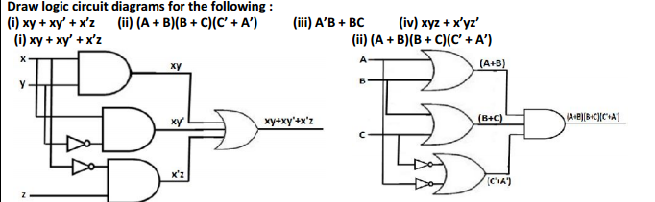

Slide 39
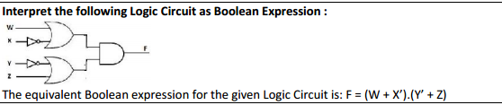

Slide 40
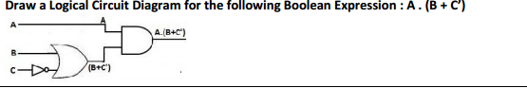

Slide 41
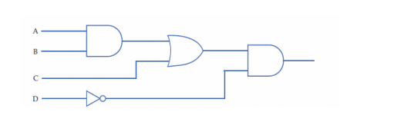
Draw logic circuit diagram for the following
AB+CD’

Slide 42
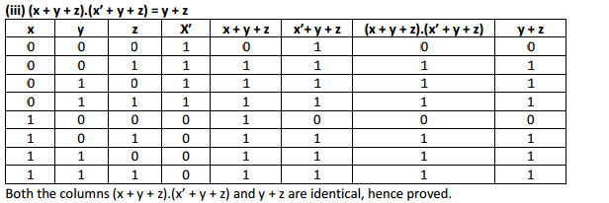

Slide 43
NAND and NOR are known as universal gates because
They are inexpensive to manufacture in comparison of other gates.
Secondly,any boolean function can be constructed using only NAND gates or only NOR gates,It is much easier to build complex integrated circuits from the same basic building blocks than it is to construct an integrated circuit using different basic gates.

Slide 44
IMPLEMENTATION OF BASIC GATES USING NAND GATES

Slide 45
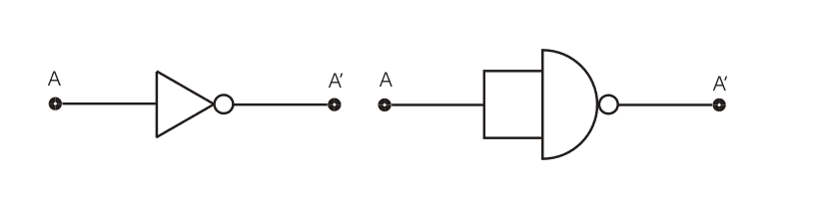
IMPLEMNTATION OF NOT GATE BY NAND GATE

Slide 46
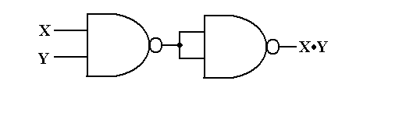
IMPLEMENTATION OF AND GATE BY USING NAND GATE
X.Y

Slide 47
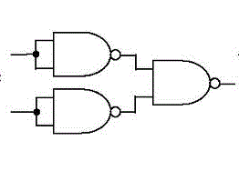
IMPLEMENTATION OF OR GATE BY USING NAND GATE
X
X
X+Y
Y
Y
X.Y

Slide 48
IMPLEMENTATION OF BASIC GATES USING NOR GATES

Slide 49
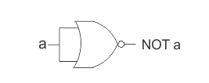
IMPLEMENTATION OF NOT GATE USING NOR GATE

Slide 50
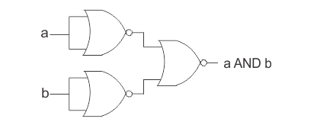
IMPLEMENTATION OF AND GATE USING NOR GATE
A
A.B
B

Slide 51
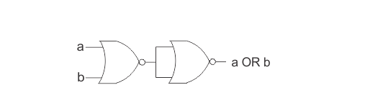
IMPLEMENTATION OF OR GATE USING NOR GATE
A+B
A+B

Slide 52
NAND to NAND and NOR to NOR
Any combinational circuit is possible using only NAND or NOR gate because of this NAND and NOR gates are called universal gates.
Since logic operations,AND,OR and NOT can be implemented with NAND ,NOR gates.

Slide 53
Any logic function can be implemented using NAND gates only by the following steps
1)The logic function has to be written in SOP form(Sum of Products)
2)Draw the logic circuit with AND and OR gates
3)Replace all AND and OR gates by NAND gates.

Slide 54
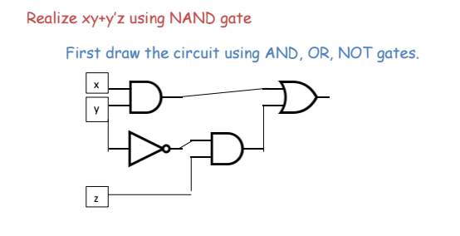

Slide 55
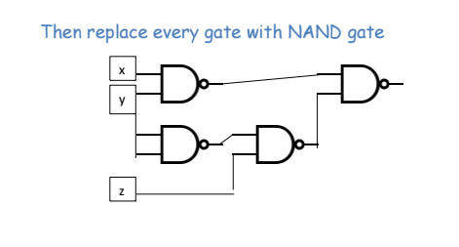

Slide 56
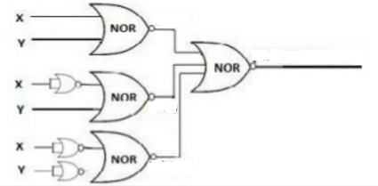
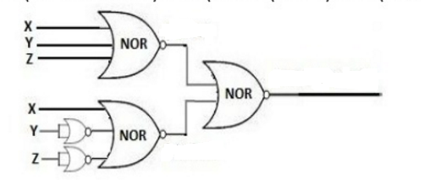

Slide 57
Any logic function can be implemented with NOR gates only by the following steps:
1)First the logic function has to written in Product of sum form(POS)
2)Draw the logic circuit with AND and OR gates.
3)Replace all AND and OR gates with NOR gate.

Slide 58
Basic Theorems of Boolean Algebra
Properties of 0 and 1
a)0+X =X
b)1+X=1
C) 0.X=0
D)1.X=X

Slide 59
Idempotence Law
X+X=X
X.X=X

Slide 60
Involution Law
(X’)’ = X

Slide 61
Complementarity Law
X + X’ = 1
X.X’ = 0

Slide 62
Commutative Law
X+Y=Y+X
X.Y=Y.X

Slide 63
Associatiative Law
X+(Y+Z)=(X+Y)+Z
X.(Y.Z)=(X.Y).Z

Slide 64
Distributive Law
X(Y+Z)=XY+XZ
X+YZ=(X+Y)(X+Z)

Slide 65
Absorption Law
X+XY=X
=X(1+Y)
=X(1)
=X
X(X+Y)=X

Slide 66
Summary Of Boolean Laws

Slide 67
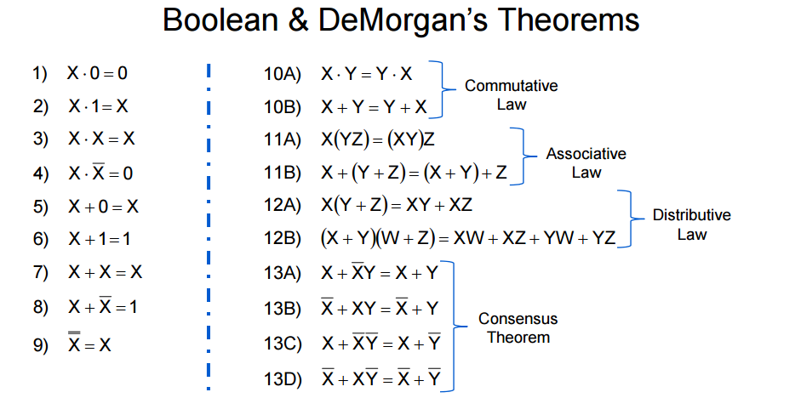

Slide 68
Using Laws of boolean algebra prove that
A’B’C’D’ + A’B’CD’ + A’BCD + AB’C’D’ + ABCD + A B’D=B’D’ + AB’ + BCD
Lhs = A’B’C’D’ + A’B’CD’ + A’BCD + AB’C’D’ + ABCD + A B’D
Applying Distributive Law
=A’B’D’(C’+C)+BCD(A’+A)+AB’D’(C’+C)+AB’D
Applying inverse law and identity law
=A’B’D’+BCD+AB’D’+AB’D
=B’D’(A’+A)+BCD+AB’D
=B’D’+BCD+AB’D
Applying Distributive Law
=B’(D’+AD)+BCD --- Absorbtion law
=B’(D’+A)+BCD
=B’D’+B’A+BCD
=B’D’+AB’+BCD

Slide 69
X’y’z’+x’y’z+x’yz+x’yz’+xy’z’+xy’z=x’+y’
=x’y’(z’+z)+x’y(z’+z)+xy’(z’+z)
=x’y’.1+x’y.1+xy’.1
=x’y’+x’y+xy’
=x’(y’+y)+xy’
=x’.1+xy’
=x’+(x.y’)
=(x’+x).(x’+y’)
=1.(x’+y’)
=1.x’+1.y’
=x’+y’

Slide 70
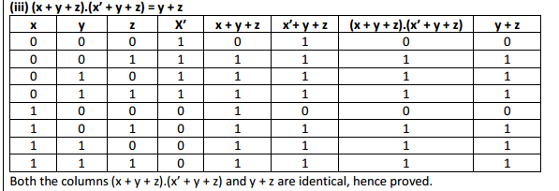

Slide 71
(x+y)(x’+y)
=x.x’+xy+yx’+yy
=0+xy+yx’+yy (as a.a’=0,a.a=0)
=0+xy+yx’+y
=y(x+x’)+y
=y(1)+y
=y+y
=y

Slide 72
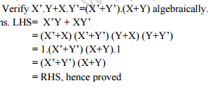

Slide 73
(A+B)(A+C)=A+BC
LHS=(A+B)(A+C)
=A.A +A.B +A.C+B.C
=A+AB+AC+BC
=A(1+B)+AC+BC
=A.1+AC+BC
=A+AC+BC
=A(1+C)+BC
=A.1+BC
=A+BC

Slide 74
X’y’z’+x’y’z+x’yz+x’yz’+xy’z’+xy’z=x’+y’
=x’y’(z’+z)+x’y(z’+z)+xy’(z’+z)
=x’y’.1+x’y.1+xy’.1
=x’y’+x’y+xy’
=x’(y’+y)+xy’
=x’.1+xy’
=x’+(x.y’)
=(x’+x).(x’+y’)
=1.(x’+y’)
=1.x’+1.y’
=x’+y’

Slide 75
Using boolean laws prove that
(A+B’+C’)(A+B’C)=A+B’C
LHS=A.A+AB’C+B’A+B’B’C+C’A+C’B’C
=A+AB’C+AB’+B’C+AC’+BC’C
=A+AB’C+AB’+B’C+AC’+B.O
=A+AB’+AC’+AB’C+B’C+0
=A(1+B’+C’+B’C)+B’C
=A.1+B’C
=A+B’C

Slide 76
De Morgans Law

Slide 77
In set theory,de morgans law relates the three basic set properties to each other,the union ,the intersection and the complement.One of the most powerful identities used in boolean algebra i.e De Morgans Theorem.
Augustus De Morgan had paved the way to Boolean algebra by discovering two important theorems.

Slide 78
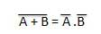
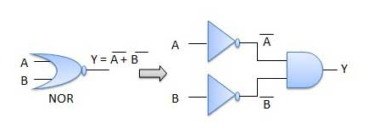
De Morgans First Theorem

Slide 79
To prove this theorem,we need to recall the complementarity laws which states that
X+X’=1 and X.X’=0 that is a logical variable when added to its complement,produces output 1 and when multiplied with complement produces the output 0.
To prove de morgans law we will use the complementarity laws.

Slide 80
Let us assume that P=X+Y
Where P,X,Y are logical variables.Then according to complementation laws P+P’=1 and P.P’=0.
This means that if P,X,Y are boolean variables then the complementarity laws must hold for variable P.

Slide 81
X+Y+X’.Y’=1
AND
X+Y.X’.Y’=0

Slide 82
Let us prove the first part
X+Y+X’.Y’=1
=((X+Y)+X’)((X+Y)+Y’)
=(X+Y+X’)(X+Y+Y’)
=(X+X’+Y)(X+Y+Y’)
=(1+Y)(X+1)
=1.1
=1

Slide 83
Let us now prove the second part
X+Y.X’.Y’=0
=X’Y’(X+Y)
=X’Y’X+X’Y’Y
=0.Y’+X’.0
=0+0
=0

Slide 84
De Morgans second theorem
It states that
(X.Y)’=X’+Y’

Slide 85
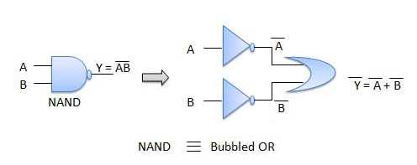

Slide 86
1ST Part X.Y+(X’+Y’)=1
2ND Part X.Y.(X’+Y’)=0
1ST part X.Y+(X’+Y’)=1
X.Y+(X’+Y’)
=(X’+Y’+X)(X’+Y’+Y)
=(X+X’+Y)(X’+Y’+Y)
=(1+Y’)(X’+1)
=1.1
=1

Slide 87
2ND PART
X.Y.(X’+Y’)=0
=X.Y.X’+X.Y.Y’
=XX’Y+XYY’
=0.Y+X.O
=0+0
=0

Slide 88
Although the above identities represent de morgans theorem,the transformation is easily performed by the following steps
1)Complement the entire function.change all the AND’s to OR’s and all the OR’s to AND’s .
Complement each of the individual variables

Slide 89
DEMORGAN’S LAW
It states that
1) (X+Y)’ = X’.Y’
2)(X.Y)’ = X’ + Y’

Slide 90
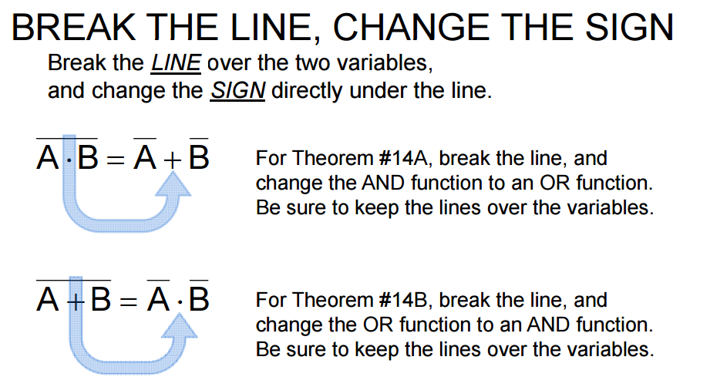

Slide 91
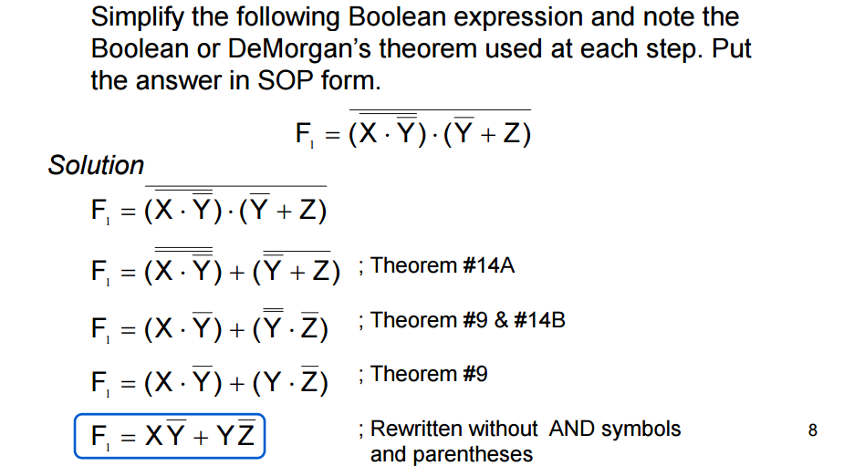

Slide 92
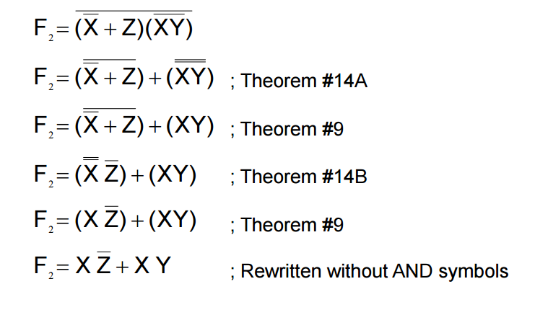

Slide 93
Duality Principal
The principal of duality is an important principal in boolean algebra.
It states that another boolean relation can be derived by:
1)Chaging each OR sign(+)to an AND sign(.)
2)Changing each AND sign (.)to an OR sign(+)
3)Replacing each 0 by 1 and each 1 by 0.

Slide 94
Eg:
X+1=1
X.0=0
0+0=0
1.1=1
0+1=1
1.0=0

Slide 95
A(B+C)=A.B+A.C
The dual will be
A+(B.C)=(A+B)(A+C)

Slide 96
Find the dual of the following
(A+B)(AC’ +B)
=(A.B)+(A+C’).B
2)A+A’B=A+B
=A.(A’+B)=A.B
3)(X+Y).(X’+Y’)
=X.Y+X’.Y’

Slide 97
Find the dual of
(U+W)(V’U+W)
=UW+(V’+U)W

Slide 98
Simplify the following using boolean laws
F=AB(A+C)+AB(A+B+C)
=AB+(A+C)+AB(ABC)
=A+B+AC+ABC
=A+B+AC(1+B)
=A+B+AC
=A(1+C)+B
=A+B

Slide 99
AB+BC+CA=AB+BC+CA
=AB+BC+CA
=(AB)(BC)(CA)
=(A+B)(B+C)(C+A)
=(A+B)(A+C)(B+C)
=(A+BC)(B+C)
=AB+BBC+AC+BCC
=AB+BC+AC+BC
=AB+BC+BC+AC
=AB+BC+AC

Slide 100
Derivation of Boolean Expression
Boolean expression which consists of a single variable or its complement,example x or y or z’ are known as literals.
The two terms ob boolean expression are
Min term
Max Term

Slide 101
Min Term
One of the most poweful theorem within boolean algebra states that any boolean function can be expressed as the sum of products of all the variables within the system.
For example x+y can be expressed as sum of several products,each of the products containing letters x and y.

Slide 102
A min term is a product of all the literals (with or without the bar )within the logic system.
When values are given for different variables,min terms can be easily formed.
Eg if x=0,y=1,z=0.Then min term will be x’.y.z’
(For a varaible with value 0 take its complement )

Slide 103
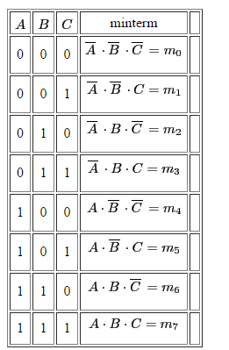
Truth table min term 3 input

Slide 104
Steps involved in min term expansion of expression
1)Convert the given expression in SOP form(Sum of products)
2)In each term if any variable is missing ,multiply that term with (missing term + missing term)
3)Expand the expression
4)Remove all duplicate terms and we will have the min term form of an expression.

Slide 105
Convert X+Y to minterns
=X(Y+Y’)+Y(X+X’)
=XY+XY’+XY+X’Y
=XY+XY’+X’Y

Slide 106
Max Terms
A max term is the sum of all the literals(With or without the bar )within the logic system.
In max term the value of a variable is 1,then its complement is added.

Slide 107
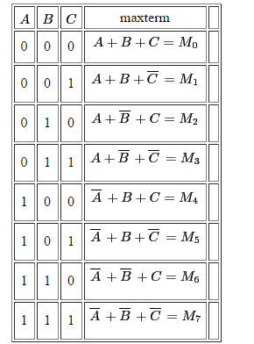

Slide 108
Canonical Expression
A boolean expression composed entirely either of min terms or max terms is referred to as canonical expression.
Canonical expression can be represented in the following two forms
1)Sum of Products(SOP)
2)Product of Sum(POS)

Slide 109

Sum of Products
A canonical expression composed of min terms is called sum of products form.
Eg F=X’YZ+XY’Z’+XYZ
The canocial form is the designation of the minterm
F= (3,4,7)

Slide 110
A boolean function may be expressed algebrically from a given truth table by forming a min term for each combination of the variable which produces an output 1 in the function and then taking OR of all those terms.
Eg:The given truth table expresses the function f(x,y,z)in the sum of products.Find the canonical form.

Slide 111
X | Y | Z | F
0 | 0 | 0 | 0
0 | 0 | 1 | 1
0 | 1 | 0 | 1
0 | 1 | 1 | 0
1 | 0 | 0 | 1
1 | 0 | 1 | 0
1 | 1 | 0 | 0
1 | 1 | 1 | 1
X’Y’Z
X’Y Z’
X Y’Z’
X Y Z
F(X,Y,Z)=X’Y’Z+X’YZ’+XY’Z’+XYZ

Slide 112
Product of Sum
When a boolean expression is represented purely as a product of maxterm ,it is said to be canonical product of sum formed of an expression.
Express in the product of sum form ,the boolean function f(x,y,z)and the truth table for which is given below

Slide 113
X | Y | Z | F
0 | 0 | 0 | 1
0 | 0 | 1 | 0
0 | 1 | 0 | 1
0 | 1 | 1 | 0
1 | 0 | 0 | 1
1 | 0 | 1 | 0
1 | 1 | 0 | 1
1 | 1 | 1 | 1
X+Y+Z’
X+Y’+Z’
X’+Y+Z’
F(X,Y,Z)=(X+Y+Z’)(X+Y’+Z’)(X’+Y+Z’)

Slide 114
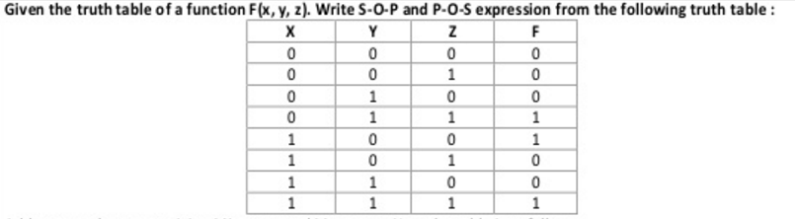

Slide 115
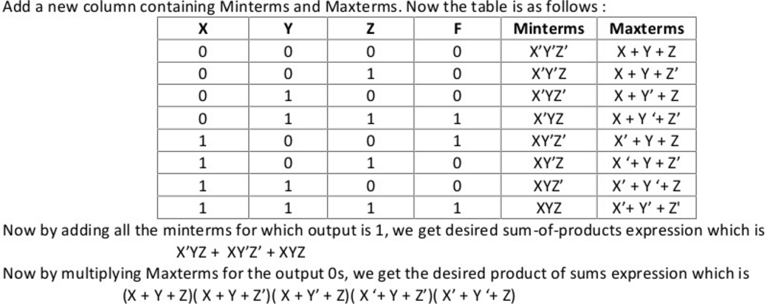

Slide 116
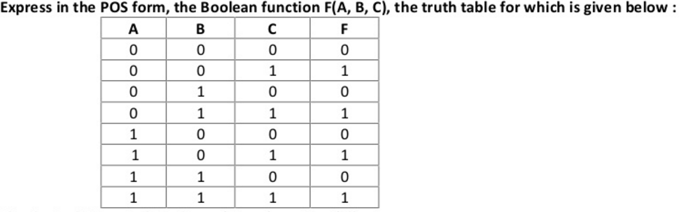

Slide 117
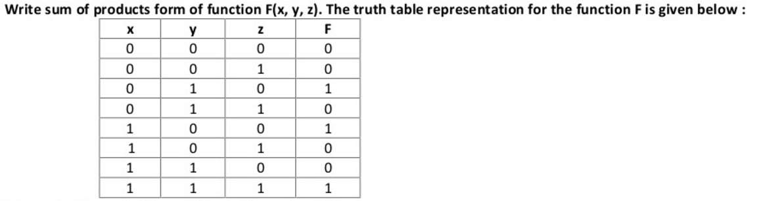

Slide 118
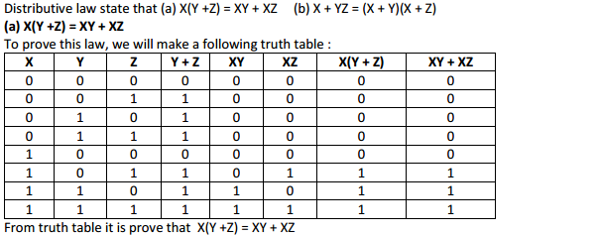
State and verify the distributive law using truth table

Slide 119
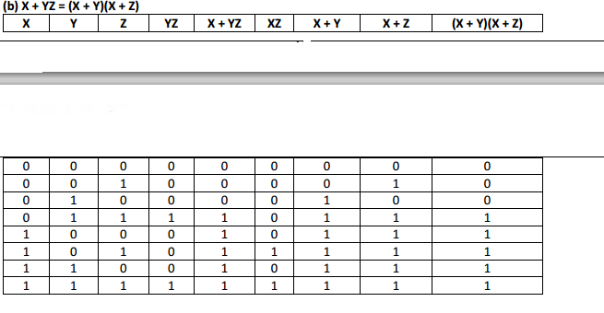

Slide 120
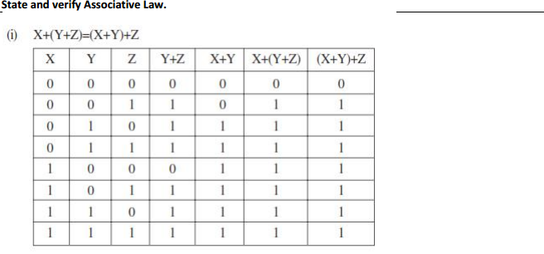

Slide 121
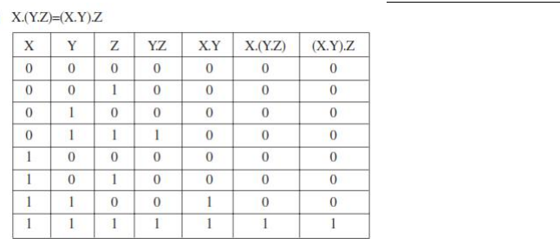

Slide 122


Slide 123
Seven invertors are cascaded after one another.What will be the output if the input is 1?
Ans 0

Slide 124

Karnaugh Maps

Slide 125


Slide 126


Slide 127


Slide 128


Slide 129


Slide 130


Slide 131


Slide 132


Slide 133


Slide 134



Slide 135


Slide 136



Slide 137


Slide 138


Slide 139


Slide 140


Slide 141


Slide 142


Slide 143


Slide 144


Slide 145


Slide 146


Slide 147
Obtain a simplified form for the following boolean expression using K maps
F(abcd)= (0,1,2,3,4,5,10,11,15)
Also draw the logic circuit diagram for the simplified expression using basic gates

Slide 149

Half Adder
Half adder is a combinational circuit that performs the addition of two bits,this circuit needs two binary inputs and two binary outputs

Slide 150
Truth Table Half Adder
A | B | SUM | CARRY
0 | 0 | 0 | 0
0 | 1 | 1 | 0
1 | 0 | 1 | 0
1 | 1 | 0 | 1
S=A’B+AB’
C=AB

Slide 151

Circuit for half adder

Slide 152


Slide 153
Full Adders
The main difference between a half-adder and a full-adder is that the full-adder has three inputs and two outputs. The first two inputs are A and B and the third input is an input carry designated as CIN.
the output S is an EXOR between the input A and the half-adder SUM output with B and CIN inputs.

Slide 154
Thus, we can implement a full adder circuit with the help of two half adder circuits.
The first will half adder will be used to add A and B to produce a partial Sum. The second half adder logic can be used to add CIN to the Sum produced by the first half adder to get the final S output. If any of the half adder logic produces a carry, there will be an output carry. Thus, COUT will be an OR function of the half-adder Carry outputs.

Slide 155



Slide 156


Slide 157


